Slide 1
Sampling Distribution
Chapter 17 Proportions

Slide 2
Central Limit Theorem
For larger and larger sample size n, we expect the Sampling Distribution’s
shape to become more Normal (unimodal and symmetric)
center to stay the same
spread to become smaller
For Quantitative Data:
SD = $\frac{σ}{\sqrt{n}}$ where $σ=\text{standard} \text{deviation} \text{of} \text{the} \text{population}$
For Categorical Data:
SD =$\sqrt{\frac{p(1−p)}{n}}$ where p = proportion in the population

Slide 3
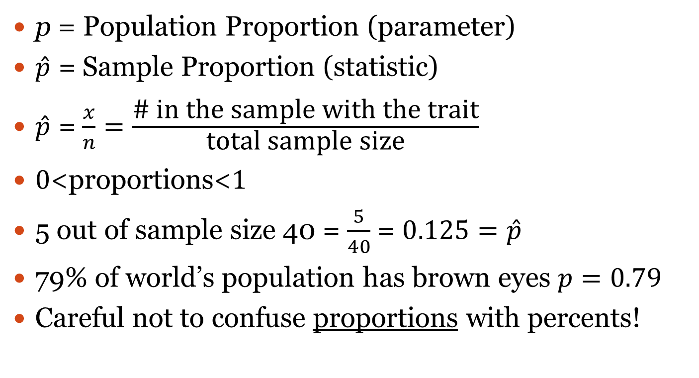
Proportions, $\hat{p}$ = $\frac{x}{n}$
p = Population Proportion (parameter)
$\hat{p}$ = Sample Proportion (statistic)
$\hat{p}$ = $\frac{x}{n}=\frac{\text{\# }\text{in} \text{the} \text{sample} \text{with} \text{the} \text{trait}}{\text{total} \text{sample} \text{size}}$
$0$<proportions<$1$
5 out of sample size 40 = $\frac{5}{40}$ = $0.125=\hat{p}$
79% of world’s population has brown eyes $p=0.79$
Careful not to confuse proportions with percents!

Slide 4
When does the Central Limit Theorem work?
Independence Assumption: The sampled values must be independent of each other.
Randomization Condition: The data values must be sampled randomly.
10% Condition: When the sample is drawn without replacement, the sample size, n, should be no more than 10% of the population.
Sample Size Assumption: The sample size must be sufficiently large.

Slide 5
For Categorical Data
Sample Size Assumption: The sample size must be sufficiently large.
Success Clause: $np≥10$
Failure Clause: $n\left(1−p\right)≥10$
Note that the HW has $q=1−p$

Slide 6
79% of world’s population has brown eyes.
Do the conditions meet for random sample size of 10 people?
Do the conditions meet for random sample size of 50 people?
Draw the sampling distribution for a random sample size of 50 people.
Draw the sampling distribution for a random sample size of 120 people.
Calculate the probability in a random sample of 120 to have less than 70% with brown eyes.
Calculate the probability of 90 or more out of 120 that will have brown eyes.

Slide 7
1 in 10,000 have perfect pitch
What is the smallest sample size that can be used for the conditions to be satisfied?
Draw the sampling distribution for that sample size.
Calculate the probability of 18 or more of that sample size will have perfect pitch.

